Slide 1


CIS 520, Operating Systems Concepts
Lecture 7
Virtual Memory

Slide 2
Virtual Memory
CPU
Logical Memory
Memory
Physical Memory
MAR
005
MMU
0F75
Address Bus
Igor Faynberg, Bell Laboratories
Slide <number>

Slide 3
The Full Memory Map
From the Process Table entry:
0 | 7
1 | 5
2 | 3
3 | *
4 | 6
5 | *
6 | 4
Block 3
Block 30
Igor Faynberg, Bell Laboratories
Slide <number>

Slide 4
A Page Table Entry Revisited
A Valid/Invalid bit is used to indicate whether the page is in the physical memory (or in secondary storage)
A Clean/Dirty bit is used to indicate whether the frame had been written to (and thus needs to be saved to the disk)
A Locked/Unlocked bit is used to indicate whether the frame may not be touched
0 | 7 | r | v | c | u
1 | 5 | rw | v | d | u
2 | 3 | xr | v | c | u
3 | 9 | xr | v | c | u
4 | x |  | i |  | u
5 | 1 |  | v | c | l
6 | 4 | x | v | c | u
Igor Faynberg, Bell Laboratories
Slide <number>

Slide 5
Memory Reference String
The memory references come from two sources:
  Code references (by PC)
  Data references (by the MAR register)
A sequence of page references over the life of a program constitutes a memory reference string.
Igor Faynberg, Bell Laboratories
Slide <number>

Slide 6
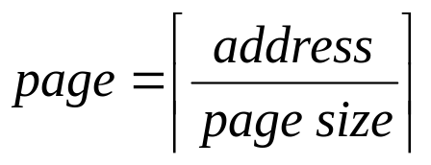
A Memory Reference String Example:
Memory measurement unit: 1 byte
Page size: 250 Instruction size: 4 bytes (one word)
PC at: 480 SP at: 25004
480: MOVEW @2000, R1
484: MOVEW R1, @SP
488: SUBI SP, #4
492: JSR @5120
496: ADDI SP, #4
500: CMP R0, #0
504: JNZ @5152
1, 8,
1, 100,
1,
1, 20, 100, [subroutine string], …
1,
2,
2 or [2, 20]
1, 8, 1, 100, 1, 1, 20, 100, ... 1, 2, 2
Igor Faynberg, Bell Laboratories
Slide <number>

Slide 7
Pages: Virtual Memory, Physical Memory, Disc
0
1
2
3
4
5
B₁
B₂
B₃
B₄
B₅
B₆
0
1
2
3
4
5
6
7
A₁
B₄
A₆
A₂
B₃
B₅
x
x
0
1
2
3
4
5
A₁
A₂
A₃
A₄
A₅
A₆
A₁ | A₂ | A₃ | A₄
A₅ | A₆ | B₁ | B₂
B₃ | B₄ | B₅ | B₆
The Process B Virtual Memory
Free Frame List: 6,7
Physical Memory
The Process A Virtual Memory
Disk
Igor Faynberg, Bell Laboratories
Slide <number>

Slide 8
What Happens on a Page Fault
The MMU causes a bus error
The CPU saves the PC and SP (and possibly some other useful information that would help determine the cause) on the stack, disables interrupts, and jumps to the appropriate interrupt service routine
The interrupt service routine saves all registers, determines that page fault occurred, adjusts the interrupt mask, and calls the appropriate memory management routine
The memory management routine checks if the address is within the process space; if not, the process is killed, and the scheduler is called
If the address is within the space, the memory management routine tries to find a free frame; if it cannot, it selects the victim for paging out
If the selected frame is dirty, the frame is marked as locked, and the I/O is scheduled to write it to the disk
While the I/O is taking place, the scheduler is called, and another process ends up running; when the page is written, it is marked clean
This is why!
Igor Faynberg, Bell Laboratories
Slide <number>

Slide 9
What Happens on a Page Fault (cont.)
As soon as the frame is clean, the memory manager computes the disc address of the page to bring in, locks the frame, and schedules an I/O, again releasing the CPU
When the I/O is completed; the page table is updated appropriately, and the page is unlocked
The memory manager returns to the interrupt routine that called it (most likely, in the context of another process!)
The interrupt routine restores the process state, reloads the registers, and returns from the interrupt
Igor Faynberg, Bell Laboratories
Slide <number>

Slide 10
A Few Notes
The paging discipline described here is Paging on Demand (a page is brought into memory when the page fault occurs)
When no frame is free, it takes almost twice as long to fix the page fault than in the presence of a free frame. This is mitigated by using a paging daemon, which pages out frames when it notices that very few free frames are available
But so far we have never said how the victim for paging out is selected!
Igor Faynberg, Bell Laboratories
Slide <number>

Slide 11
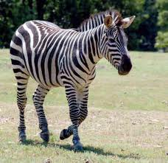
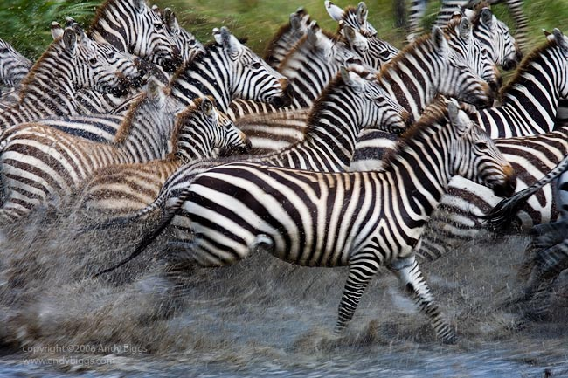
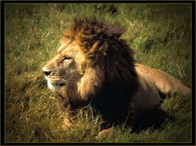
So, how can we select a page to evict?
?
Igor Faynberg, Bell Laboratories
Slide <number>

Slide 12
Page Replacement Algorithms
It is possible to pick a victim randomly, but the idea is to select a page that would not be used soon—too much overhead is involved!
There are tons of page replacement algorithms
For each such (implementable) algorithm, it is possible to write a program that would perform the worst if this algorithm is chosen...
Well, we will start with an unimplementable algorithm!
Igor Faynberg, Bell Laboratories
Slide <number>

Slide 13
Page Replacement Algorithms
Optimal (unimplementable, but essential for benchmarking)
Most-Recently-Used (MRU)
Not-Recently-Used (NRU)
Least-Frequently-Used (LFU)
First-In-First-Out (FIFO)
  Second Chance
    Clock
Least-Recently-Used (LRU)
  Not-Frequently-Used (NFU)
    Aging
Igor Faynberg, Bell Laboratories
Slide <number>

Slide 14
The Optimal (OPT)
Page Replacement Algorithm
Label each page with the number of instructions that will be executed before this page is referenced (is it possible?)
Update all labels after each instruction (is it feasible?)
Always page out the frame whose page has the largest label
Although this algorithm cannot be implemented, it can be used in simulations to compare a program’s performance under the OPT with that under another (implementable) page replacement algorithm. (The program can be run to determine its memory reference strings and thus the labels to be used in the simulation.)
Igor Faynberg, Bell Laboratories
Slide <number>

Slide 15
Most-Recently-Used (MRU)
The page that was just accessed is replaced
(that simple!)
Igor Faynberg, Bell Laboratories
Slide <number>

Slide 16
Least-Frequently-Used (LFU)
Keep a use count for each page (in expensive hardware)
Evict a page that has the smallest count
Igor Faynberg, Bell Laboratories
Slide <number>

Slide 17
A Page Table Entry Revisited Again
A Valid/Invalid bit indicates whether the page is in the virtual address space (or in secondary storage)
A Clean/Dirty bit indicates whether the page had been written to (and thus needs to be saved to the disk)
A Locked/Unlocked bit indicates whether the page may not/may be touched
0 | 7 | r | v | c | u | r
1 | 5 | rw | v | d | u | n
2 | 3 | xr | v | c | u | r
3 | 9 | xr | v | c | u | r
4 | x |  | i |  | u | r
5 | 1 |  | v | c | l | n
6 | 4 | x | v | c | u | r
A referenced/not-referenced bit indicates whether the page was recently (e.g., since the last clock interrupt) read
Igor Faynberg, Bell Laboratories
Slide <number>

Slide 18
The Not-Recently-Used (NRU) Page Replacement Algorithm
The operating system (possibly, with the help of hardware) keeps track of the pages’ being read and written to for a period of time
The pages are then broken into four classes:
  Never read, never written to
  Never read, written to
  Read, never written to
  Read and written to
With the NRU, a page is removed at random from the lowest-numbered non-empty class. (The strategy: it is better to remove a dirty page than a heavily used clean one.)
Igor Faynberg, Bell Laboratories
Slide <number>

Slide 19
The First-In-First-Out (FIFO) Page Replacement Algorithm
The operating system keeps the list of pages in the order they were brought into memory
With FIFO, a page in front of the list is always removed. (The strategy: if it has not been referenced for a long time, it won’t be used soon. Well...)
Igor Faynberg, Bell Laboratories
Slide <number>

Slide 20
The Second Chance
Page Replacement Algorithm
The reference bit of the oldest page is inspected. If its value is n, it is replaced immediately but if the value is r, it is given a second chance: it is put at the end of the queue and marked as though it has just arrived.
α
β
γ
δ
ε
φ
c
η
Arrival Time:
Reference bit:
12 14 18 21 28 34 48
r n r r r n n n
The Second Chance is a variation on FIFO: it replaces the oldest page (as in FIFO), but only on the condition that it has not been referenced. (The strategy: it is better to remove an old unreferenced page.)
Igor Faynberg, Bell Laboratories
Slide <number>

Slide 21
The Clock
Page Replacement Algorithm
The clock structure, keeps the pages in the circular list. The hand of the clock points at the oldest page. At the time of a page fault, if the page is unreferenced, it is removed; otherwise, the hand moves to the next page in the list.
α
η
β
c
γ
φ
δ
ε
The Clock algorithm is but an implementation of the Second Chance algorithm
Igor Faynberg, Bell Laboratories
Slide <number>

Slide 22
The Least-Recently-Used (LRU)
Page Replacement Algorithm
With the LRU algorithm, a page that has not been used for a long time (huh?! what does it mean “a long time”?) is selected as a victim for replacement.
  LRU differs from FIFO in that FIFO keeps track of the time since the page was brought into a frame rather than the time since it was last used.
  LRU differs from Optimal in that Optimal is aware of the future, while LRU uses what it knows about the past. (In a sense, Optimal is a reverse of LRU—see the Book for more on this subject.)
The strategy: if a page has not been used for a long time, it won’t be used soon.
Igor Faynberg, Bell Laboratories
Slide <number>

Slide 23
LRU: Problems and Solutions
It is very expensive to implement LRU. To do so one must
  Maintain a list of all pages in memory—a piece of cake unless one needs to
  Update it on every memory reference
What is needed to perform the task is either expensive hardware or clever software approximation
Igor Faynberg, Bell Laboratories
Slide <number>

Slide 24
Hardware Solutions for LRU
Each page table entry must have a 64-bit counter, which is automatically incremented on each memory reference. Then, on page fault, the OS selects a (why “a” and not “the”?) page with the lowest counter value as the victim
For n frames, maintain an nxn bit-matrix. If page i is referenced, the i-th row is set to all “1s”, and then the i-th column is set to all “0s”. On page fault, the entry, whose row has the lowest binary value, is chosen
Igor Faynberg, Bell Laboratories
Slide <number>

Slide 25
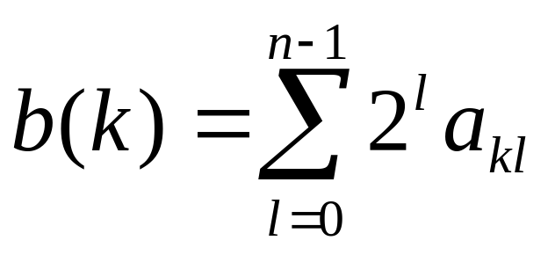
Reformulating the Matrix Algorithm
a₀₀ ... a_{0,n-1}
. . .
1 ... 0 ... 1
. . .
a_{n-1,0} ... a_{n-1,n-1}
When page i is referenced
1. Make all entries in the i-th row “1”
2. Make all entries in the i-th column “0”
On a page fault, select the value of k that minimizes
Igor Faynberg, Bell Laboratories
Slide <number>

Slide 26
An Assignment
Prove that the Matrix implementation of the LRU algorithm works. In other words, prove that
If the memory page k has just been used, then the binary value of the k-th row, b(k) is larger than b(i), for all i such that i ≥ 0; i < n, and i ≠ k; and
The inequality b(i) ≥ b(j) holds until page j is used.
Igor Faynberg, Bell Laboratories
Slide <number>

Slide 27
The Matrix LRU Algorithm Example
Consider a page reference string : 0, 1, 3, 2, 0
 | 0 | 1 | 2 | 3
0 | 0 | 1 | 1 | 1
1 | 0 | 0 | 0 | 0
2 | 0 | 0 | 0 | 0
3 | 0 | 0 | 0 | 0
 | 0 | 1 | 2 | 3
0 | 0 | 0 | 1 | 1
1 | 1 | 0 | 1 | 1
2 | 0 | 0 | 0 | 0
3 | 0 | 0 | 0 | 0
 | 0 | 1 | 2 | 3
0 | 0 | 0 | 1 | 0
1 | 1 | 0 | 1 | 0
2 | 0 | 0 | 0 | 0
3 | 1 | 1 | 1 | 0
 | 0 | 1 | 2 | 3
0 | 0 | 0 | 0 | 0
1 | 1 | 0 | 0 | 0
2 | 1 | 1 | 0 | 1
3 | 1 | 1 | 0 | 0
 | 0 | 1 | 2 | 3
0 | 0 | 1 | 1 | 1
1 | 0 | 0 | 0 | 0
2 | 0 | 1 | 0 | 1
3 | 0 | 1 | 0 | 0
Victims: 1-3 Victims: 2-3 Victim: 2 Victim: 0 Victim: 1
Igor Faynberg, Bell Laboratories
Slide <number>

Slide 28
The Not-Frequently-Used (NFU)
Page Replacement Algorithm
This is a software implementation (or rather simulation) of the LRU:
  Each page has a software counter, which is initialized to zero
  On each clock tick, the OR function of the clean(0)/dirty(1) and not referenced(0)/referenced(1) bits are added to the counter
  When a page fault occurs, the page whose counter is the lowest is removed.
A problem: NFU does not forget the history of the memory use, so the presence of the pages with high counters that are no longer used might dominate
Igor Faynberg, Bell Laboratories
Slide <number>

Slide 29
The Aging
Page Replacement Algorithm
This is a slight modification of the NFU, which fixes the “long memory” problem:
  Each page has a software counter, which is initialized to zero
  On each clock tick, the counters are shifted right (to forget one bit of history) and the OR function of the clean/dirty and referenced/not referenced bits is added to the left-most bit of the counter
  When a page fault occurs, the page whose counter is the lowest is removed.
Aging fixes the NFU problem.
Igor Faynberg, Bell Laboratories
Slide <number>

Slide 30
Happy Summary:
Page Replacement Algorithms
Optimal (unimplementable, but essential for benchmarking)
Not-Recently-Used (NRU)
Most-Recently-Used (MRU)
Least-Frequently-Used (LFU)
First-In-First-Out (FIFO)
  Second Chance
    Clock
Least-Recently-Used (LRU)
  Not-Frequently-Used (NFU)
    Aging
Igor Faynberg, Bell Laboratories
Slide <number>

Slide 31
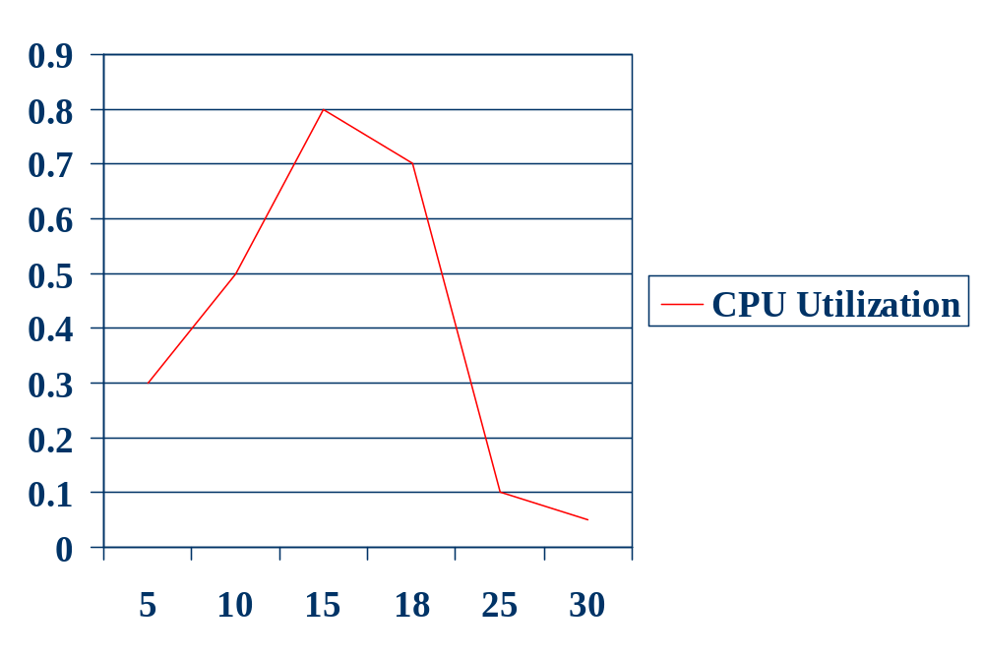
Thrashing
Number of processes
Igor Faynberg, Bell Laboratories
Slide <number>

